Slide 1


AMERICA’S ARMY:
Globally Responsive, Regionally Engaged
UNCLASS/FOUO
United States Army Student Detachment
(USASD)
Purpose:
To provide an overview of the services provided by the USASD to the best Soldiers in the United States Army
Agenda:
USASD Mission
TDA
Provided Services
In-Processing
Absence Request
Finance
Out-processing
Essential Personnel Services
Closing comments
Welcome Brief
20230419

Slide 2
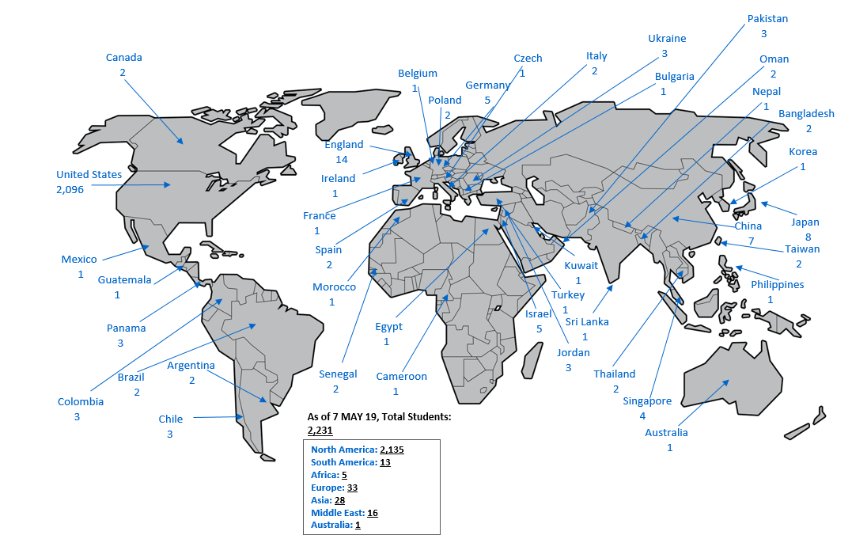
USASD Mission
Leader Training Brigade
Task Force Marshall
USA Student Detachment
Proponent Development & Integration Division
USA Master Resilience
School
USA Physical Fitness School
IMT Leadership School
USA Drill Sergeant Academy
Mission: The U.S. Army Student Detachment provides command and control, human resources and financial management support, and medical readiness to more than 1,700 U.S. Army personnel attending civilian educational institutions and designated Armed Forces Service Schools in CONUS, and OCONUS locations to ensure their successful tour of study.
Advanced Civil School (ACS) Program
- Graduate (Masters) (JD) (PhD)
Broadening Assignments
- Fellowships
- Funded Legal Education Program (FLEP)
- Office of the Chief Legislative Liaison, Strategic Education
& Development Program, Bachelor Degree Completion Program (DCP)
- Scholars: Olmsted Scholarship & General Downing Scholarship
Foreign Area Officer In-Region-Training (FAO-IRT)
Joint Service Schools ILE
- Air Command and Staff College, Maxwell Airforce Base, AL
- Marine Corps Command and Staff College, Quantico, VA
- Naval Command and Staff College, Newport, RI
- Naval Post Graduate School (NPS), Monterey, CA
Training With Industry/Acquisition Program (TWI)
Sons of Other Nations (SON) Foreign School ILE
- 114 OCONUS locations - WIAS Taskers deployment
- In-Processing (New Arrivals)
4/21/2023
2

Slide 3
USASD TDA
Commander
O4 – AG
First Sergeant
E8 – 42A
DET HQs
Human Resources Support Section
Financial Services Section
HR Supvr (MIL/OA)
GS-0201-09
HR SGT
E5 – 42A
Admin Asst
GS-0203-06
HR Asst (MIL/OA)
GS-0203-07
HR SGT
E6 – 42A
HR Asst (MIL/OA)
GS-0203-07
HR SGT
E5 – 42A
HR Asst (MIL/OA)
GS-0203-07
Pay Analyst
E5 – 36B
HR Asst (MIL/OA)
GS-0203-07
HR Asst (MIL/OA)
GS-0203-07
HR Asst (MIL/OA)
GS-0203-07
Pay Tech
E4 – 36B
HR Asst (MIL/OA)
GS-0203-07
TDA Military HR
TDA GS
TDA Military FI
AUTH TOTAL: 16
CMD: 2
HR SPT SEC: 10
FI SVC SEC: 4

Slide 4
AMERICA’S ARMY:
Globally Responsive, Regionally Engaged
UNCLASS/FOUO
What We Do For YOU!
Human Resources (HR)
Financial Management
Finance In-Processing
  Arrive Soldiers to their gaining duty location
  Charge PCS Absence
PCS Entitlements
  Basic Allowance for Housing (BAH)
  Basic Allowance for Subsistence (BAS)
  Family Separation Allowance (FSA)
  Civilian Clothing Allowance (CCA)
  Government Travel Card (GTC)
  OCONUS Cost of Living Allowance (COLA)
Command
In-Processing
Add student to In-Processing tracker
Arrive in IPPS-A
Sign-in from PCS absence
Verify student’s new address
EFMP
Security (DISS)
Policies
Accountability (Semi-Annual)
Legal actions
Medical – SUDs, hospitalizations, convalescent absence
FLAGS
IG complaints
Congressional complaints
Media management
Gainful employments
ADPAAS
Briefs
Other Services
Medical liaison (updates to MEDPROS)
Financial Liability Investigations (FLIPL)
Security management
Out-Processing
Publish PCS orders (plus Retirements, Terminal)
Sponsorship
Sign-out on PCS absence
Receive PCS orders from accessions/HRA
Package all required documents listed on out-processing checklist in one PDF File
EFMP
Security (DISS)
Move-in Housing Allowance (MIHA)
Overseas Housing Allowance (OHA)
Cost of Living Allowance (COLA) or Security Advances
Reimbursement for State Licensure and Certification Costs for the Spouse of a Soldier Arising from PCS
Deployment Entitlements
Hardship Duty Pay
Hostile Fire Pay
Combat Zone Tax Exclusion Pay
Personnel Actions
STP/Personal Profile updates
  Name changes
  Foreign Language Proficiency Bonus
  Unqualified resignations
  Voluntary and involuntary retirements, separations
  Legal actions/Suspension of Favorable Actions
  Absences (CONUS/OCONUS)
  EFMP
  Family Care Plan
  Height & Weight updated in DTMS
PCS Travel Payments (Submit via Smart Voucher direct w/DFAS)
Dislocation allowance per diem for meals & lodging
Temporary Lodging Allowance (TLA)(CONUS/OCONUS)
Joint Service Schools & NPS
USASD conducts Global Video Services thru MS-Teams and Site Visits to provide informational briefings.
Out-Processing
  Advance Pay
  Government Travel Card (GTC)
myPay: http://mypay.dfas.mil
Allows customers electronic access to:
Command & Control Support Systems
Website Management
SharePoint Management
Facebook Management
IPPS-A
LES View / Print
Allotments – Start, Stop, Change
Change Bank Account
View DFAS Vouchers paid within last 6 months
W-2 view and print
Temp Travel
TDY Orders (TDY en-route)
DTS (TDY and Return)
PTDY w/HRC approval
4/21/2023
4

Slide 5
AMERICA’S ARMY:
Globally Responsive, Regionally Engaged
UNCLASS/FOUO
United States Army Student Detachment
In-Processing

Slide 6
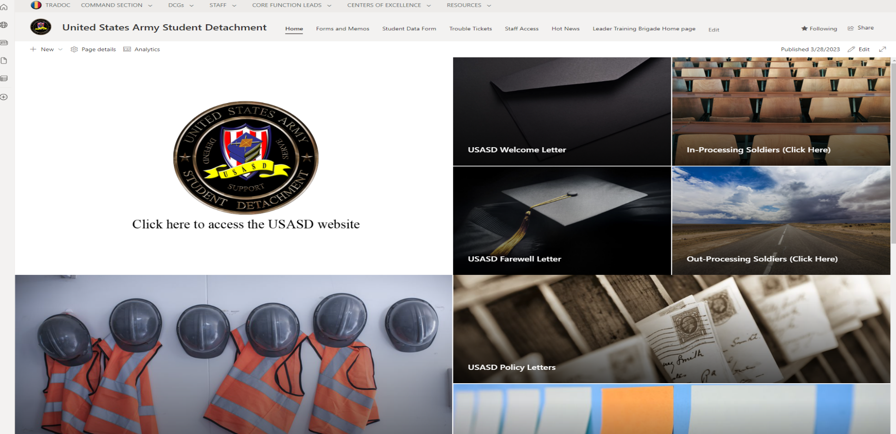
USASD In-Processing
All Students are required to use a CAC accessible computer with their Army 365 email authentication to gain access
Access SharePoint at United States Army Student Detachment - Home (sharepoint-mil.us) and communicate through Army 365 email
DO NOT in-process/create a file no earlier than 10 days before your report date
usarmy.jackson.CAC.mbx.usasd-in-processing@army.mil

Slide 7
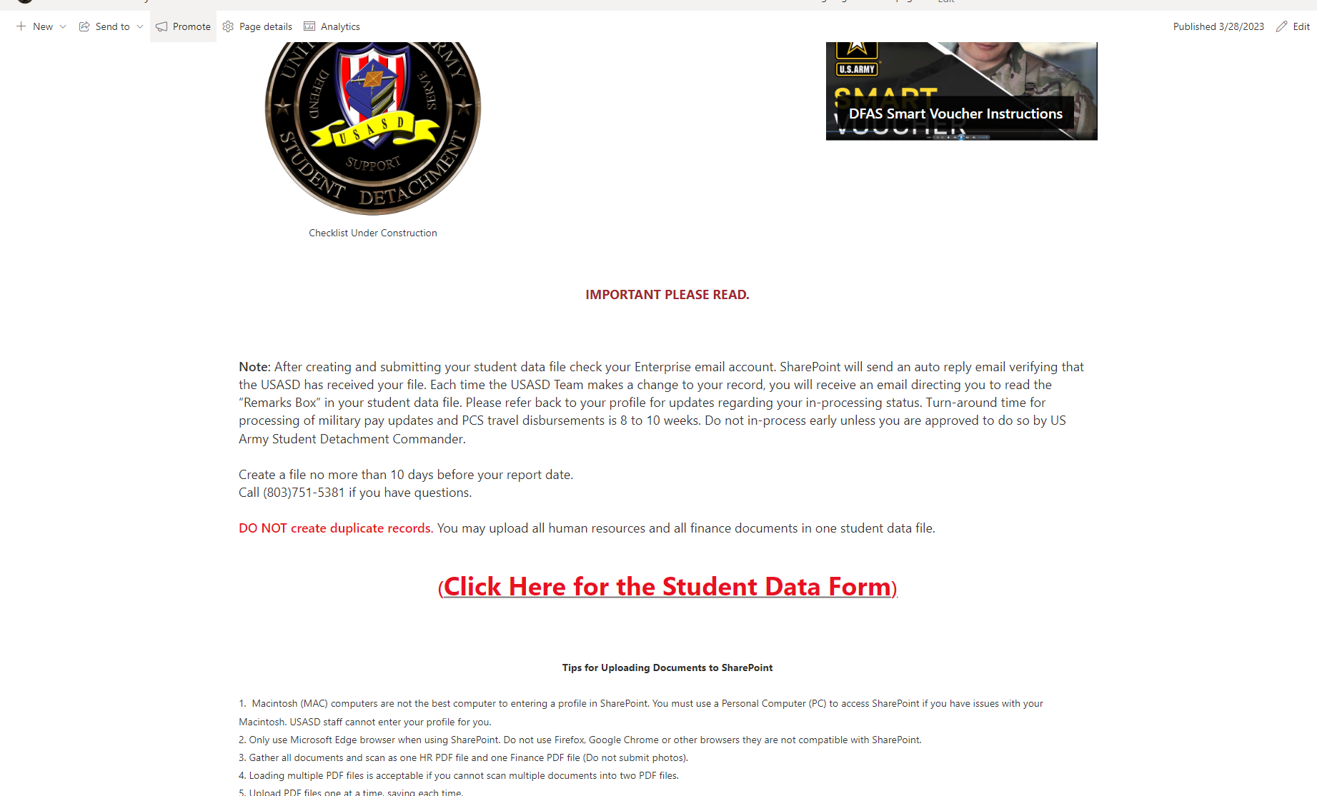
USASD In-Processing
On the Home Page "click" the In-Processing tile and scroll down until you find the Student Data Form.

Slide 8
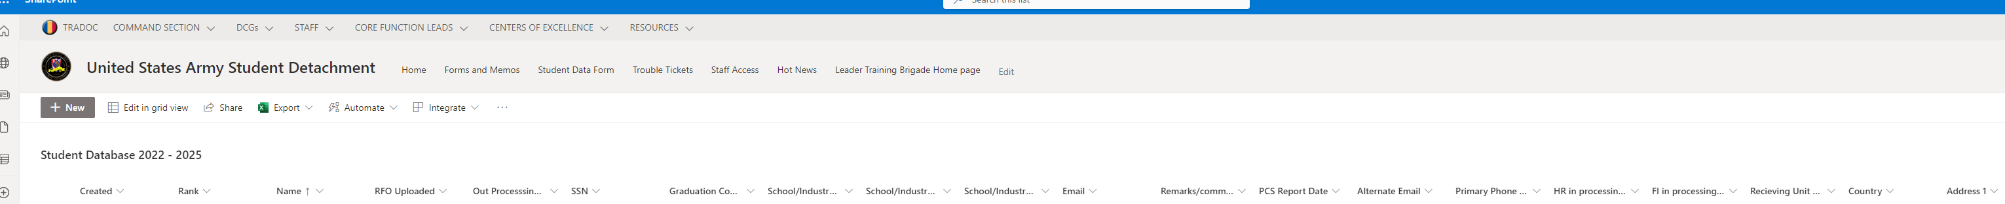
USASD In-Processing
On the Student Data Form, "click" on NEW and fill in all information and upload your documents.

Slide 9
USASD In-Processing
Soldiers will report by submitting their complete HR and finance documents via SharePoint. Scan your HR and finance documents into PDFs BEFORE logging into SharePoint. Ensure your absence request is submitted in IPPS-A according to the instructions provided in this document. If your In-Processing packet is not received, a notice will be sent to you by Army 365 email concerning your Failure to Report and risk of pay suspension
See the below checklist for documents required for HR and Finance In-Processing. Include all documents to prevent delays in your arrival to USASD
Human Resources In-processing Checklist
Do not submit photographs of your documents. Submit documents in PDF format in order to prevent delays in receiving your entitlements

Slide 10
USASD In-Processing
Student Data Form (SharePoint)
Required Documents
PCS Orders (To include amendments)
Absence Request (IPPS-A) send all i.e., PTDY, PCS
DA Form 5960 (form dated Jan 2022)
DD Form 93
Service Members' Group Life Insurance Certificate
DA Form 7415
ADPAAS “Print Screen"
Cyber Awareness Training Certificate
DD Form 1351-2 Travel Voucher
GTCC Program and Statement of Understanding
GTCC Training Certificate
* Ensure to submit all documents
4/21/2023

Slide 11
USASD In-Processing
Servicing Human Resources Assistant Representatives:
SGT Powell – (803) 751-5346 (A – M)
Ms. Rivera – (803) 751-5381 (N – Z)
HOURS OF OPERATION
Monday through Friday: 0830-1630
Phones Open for Customer Service: 1300-1600
LUNCH Monday through Friday: 1200-1300
SharePoint Link:
USASD In processing (sharepoint-mil.us)
Website Link:
USASD Home (army.mil)
Email In-Processing:
usarmy.jackson.CAC.mbx.usasd-in-processing@army.mil

Slide 12
AMERICA’S ARMY:
Globally Responsive, Regionally Engaged
UNCLASS/FOUO
United States Army Student Detachment
ABSENCE REQUEST

Slide 13
Absence Request
.
Absence Request – IPPS-A
***Per Detachment Commander:***
USASD will NOT accept absences outside of the Integrated Personnel and Pay System-Army (IPPS-A)
List Mrs. Morris, Gayle as the Supervisor
Admin absence/house hunting (PTDY) is a separate request from an absence request or PCS absence request
Combined absences must cover all days that you are not present for duty. You must be on an approved absence to begin your travel. Service members are not authorized to travel while on PTDY
Absence date must end the day before your report date
  (Example) Report Date: 21 September; Absence request last date: 20 September
  For questions or RFIs please email: usarmy.jackson.CAC.mbx.usasd-da31@army.mil
  Mrs. Gayle Morris 803-751-5325
Parental absence
OCONUS absence

Slide 14
Parental Absence Request
.

Slide 15
Parental Absence Request
How to submit Parental Absence in IPPS-A:
Use the Absence Management module and select the Request Absence category. Use the following field selections:
a. Absence Type: Select “4-Parental Absence”
b. Absence Name: Select the appropriate event for leave – Adoption of Child; Birth of Child; Fostering of Child
c. Reason: Select one of the following:
(1) 01-Primary Max Days. Soldiers taking the full period of MPLP (12-weeks)
(2) 02-Primary-Prtl-1st Increment. Soldiers taking parental leave in increments, this is the first increment requested
(3) 03-Primary-Prtl-Next Increment. Soldiers taking parental leave in increments, this is the next increment requested; any request that is not the first or the last request within increments
(4) 04-Primary-Prtl-Last Increment. Soldiers taking leave in increments, this is the last part of the incremental periods requested (when all days taken/requested equal 12-weeks parental leave)
d. The Soldier’s commander or designated authority is the approving authority

Slide 16
Absence Request
.
OCONUS ABSENCE Official and Unofficial Travel
OCONUS Absence request submitted through IPPS-A must include the following (NO EXCEPTIONS):
Refer to the Foreign Clearance Guide at: https://www.fcg.pentagon.mil/fcg.cfm. Search for the country you will travel to. Read carefully, to ensure all requirements for that country are met
If required, you must visit the Aircraft and Personnel Automated Clearance System (APACS) at: https://apacs.milcloud.mil/apacs/, to request for an APACS account

Slide 17
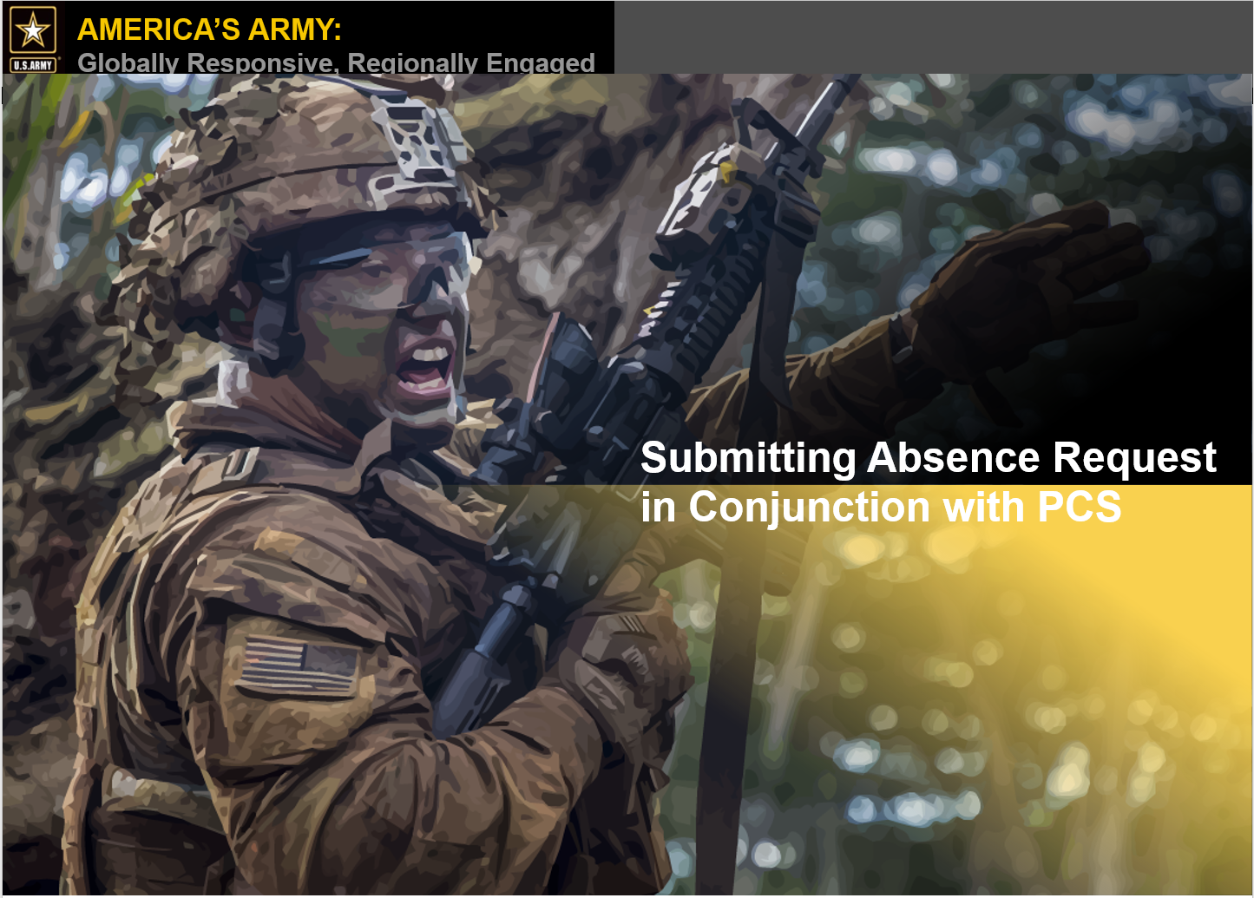
Absence Request

Slide 18
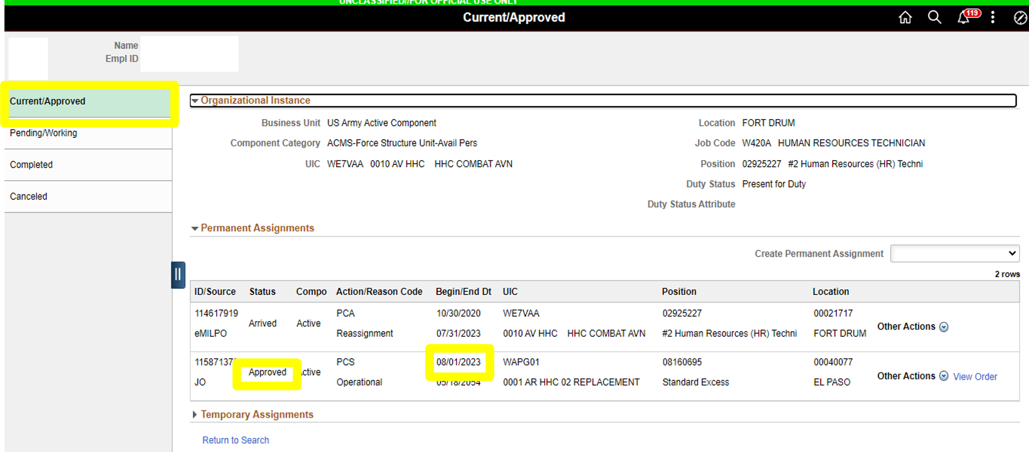
Absence Request
Example: Service member has an approved assignment with a report date of 1 August 2023
View Orders
4/21/2023

Slide 19
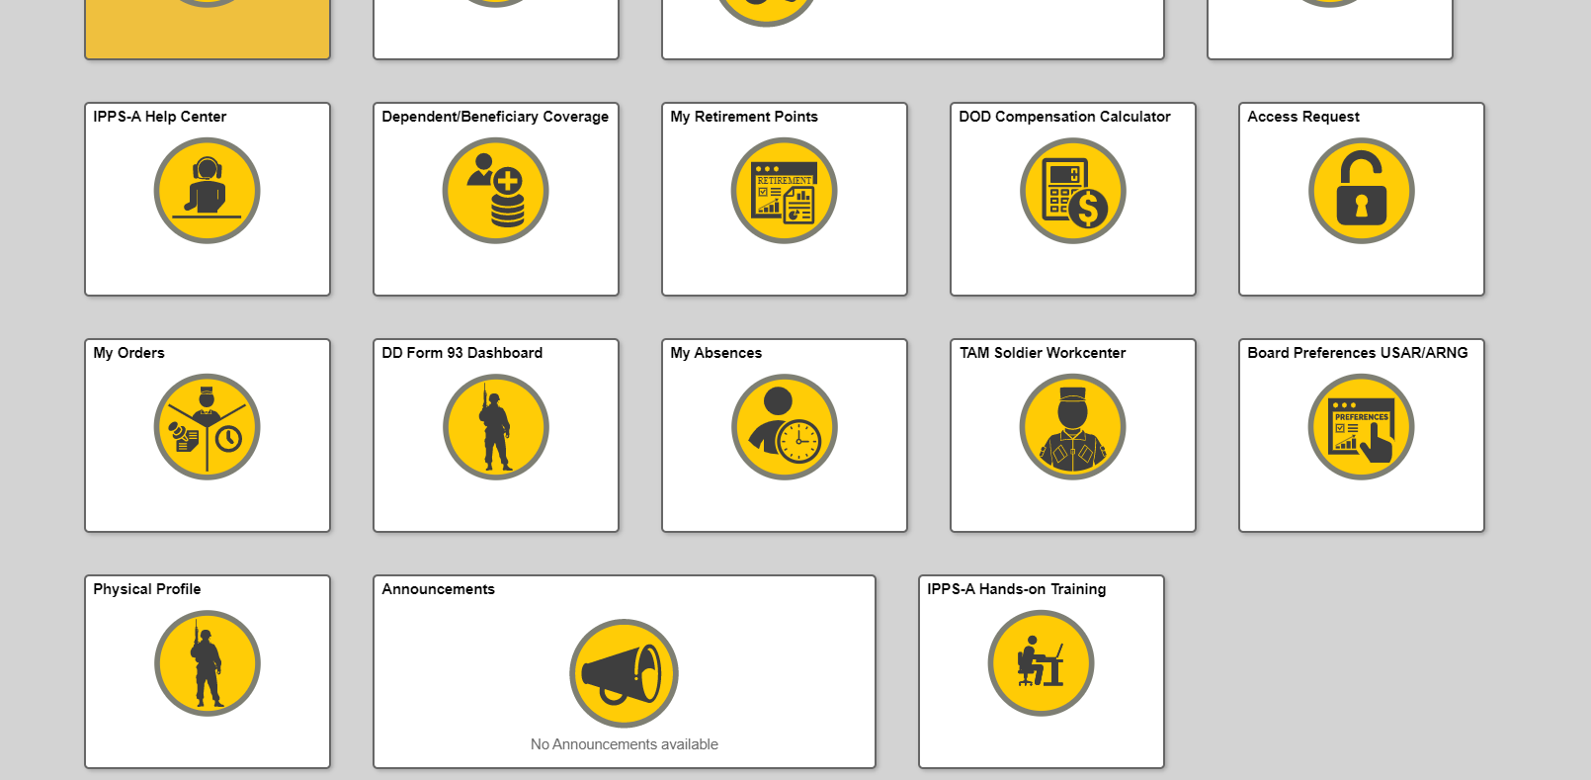
Absence Request (without House Hunting Absence)
Navigate to the “My Absences” tile and submit for an Absence Request in Conjunction with PCS
4/21/2023

Slide 20
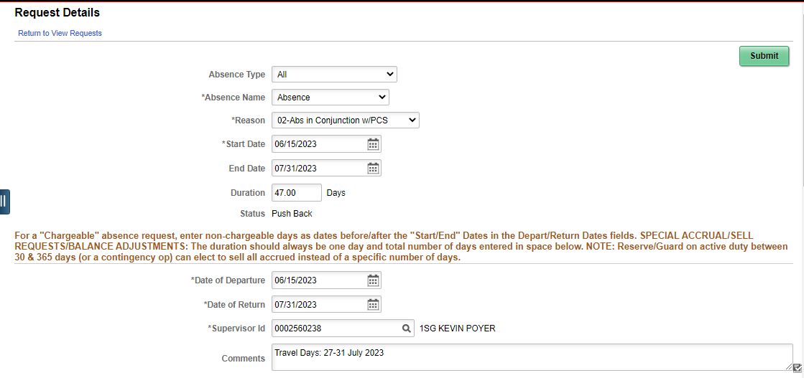
Absence Request (without House Hunting Absence)
IAW the IPPS-A User’s Manual, Authorized Travel days are either automatically determined by DTOD or manually entered by the unit when processing the arrival at the gaining installation.
In the above example, it appears as if the service member will be charged 47 days. However, during the arrival process, the ATD will automatically calculate based on losing and gaining unit zip codes. In the event the days need to be adjusted, the in-transit grid will allow the HR Pro to adjust as necessary prior to processing the absence through DJMS
It is not necessary to annotate the ATD in the comments because it’s automatically calculated, but you may do so as shown in the above example
Absence may only require unit commander approval (pending unit SOP/policies)
4/21/2023
Notes:
Key Notes:
-Authorized Travel Days (ATD) are either automatically determined by Defense Table of Official Distances (DTOD) or manually entered by the unit when processing the arrival.
-In the above example, it appears as if the Service member will be charged 47 days, however, during the arrival process, the ATD will automatically calculate based on losing and gaining unit zip codes. In the event the days need to be adjusted, the in-transit grid will allow the HR Pro to adjust, as necessary prior to processing the absence through DJMS.
-It is not necessary to annotate the ATD in the comments because it’s automatically calculated, but you may do so as shown in the above example. It is optional.
-Absence may only require unit commander approval (pending unit SOP/policies

Slide 21
Absence Request (with House Hunting Absence)
Navigate to the “My Absences” tile and submit for an Absence Request in Conjunction with PCS
4/21/2023

Slide 22
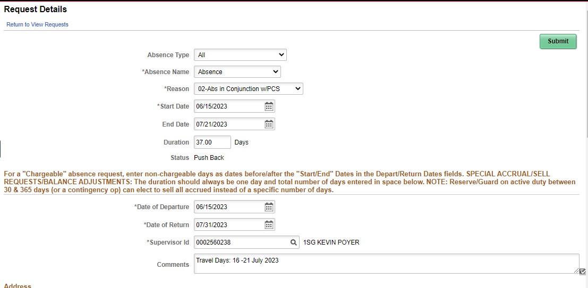
Absence Request (with House Hunting Absence)
Enter Chargeable days on top
Enter entire absence period
**Reminder**: Authorized Travel Days (ATD) will be automatically determined by the Defense Table of Official Distances (DTOD) or manually entered by the unit when In-Processing. The 37 chargeable days in the example above will adjust upon arrival to gaining unit
Absence may only require unit commander approval (pending unit SOP/policies)
4/21/2023
Notes:
Key Notes:
**Reminder*** : Authorized Travel Days (ATD) will be automatically determined by Defense Table of Official Distances (DTOD) or manually entered by the unit when processing the arrival. The 37 chargeable days in the example above will adjust upon arrival to gaining unit.
-Absence may only require unit commander approval (pending unit SOP/policies

Slide 23
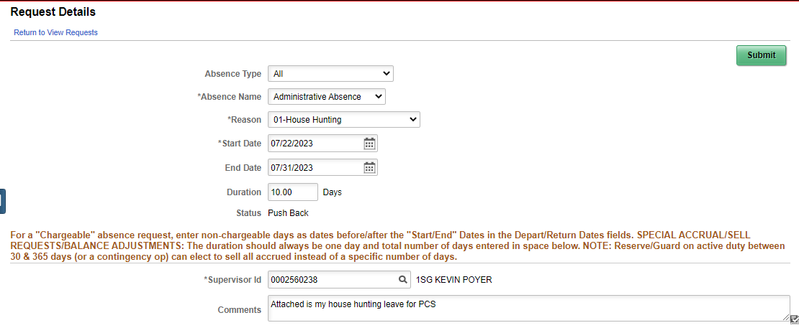
Absence Request (with House Hunting Absence)
Enter the House Hunting dates as shown above
The House Hunting period will begin after the “Absence in conjunction with PCS” period
Submit both transactions for approval simultaneously
4/21/2023
Notes:
Key Notes:
-Enter the House Hunting dates as shown above.
-House Hunting may be entered before or after the ‘Absence in conjunction with PCS’ period as long as the ‘Absence in conjunction with PCS’ has the entire absence period annotated as shown in the previous slide
-Ensure the proper approval authority signs the request for House Hunting. Recommend having Housing Hunting be signed prior to approving PCS Absence.

Slide 24
Absence Request
Servicing Human Resources Assistant Representative:
Ms. Morris – (803) 751-5325
HOURS OF OPERATION
Monday through Friday: 0830-1630
Phones Open for Customer Service: 1300-1600
LUNCH Monday through Friday: 1200-1300
Email absence box:
usarmy.jackson.CAC.mbx.usasd-da31@army.mil

Slide 25
AMERICA’S ARMY:
Globally Responsive, Regionally Engaged
UNCLASS/FOUO
United States Army Student Detachment
FINANCE

Slide 26
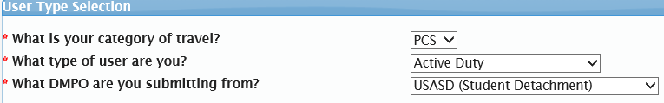
Smart Voucher
Special Instructions
Make sure both SIGN IN date and end date of travel voucher MATCH
Attach ALL documents to smart voucher:
  ORDERS
  DA 31 or Absence request
  RECIEPTS
Under location of TLE tab if the question below is not a yes, you will not receive TLE.
Questions on what is reimbursable?
- Refer to the Joint Travel Regulation (Chapter 1 - 6 )
DA 31 must be SIGNED in
USASD needs to be selected. If not, it will not come to us.

Slide 27
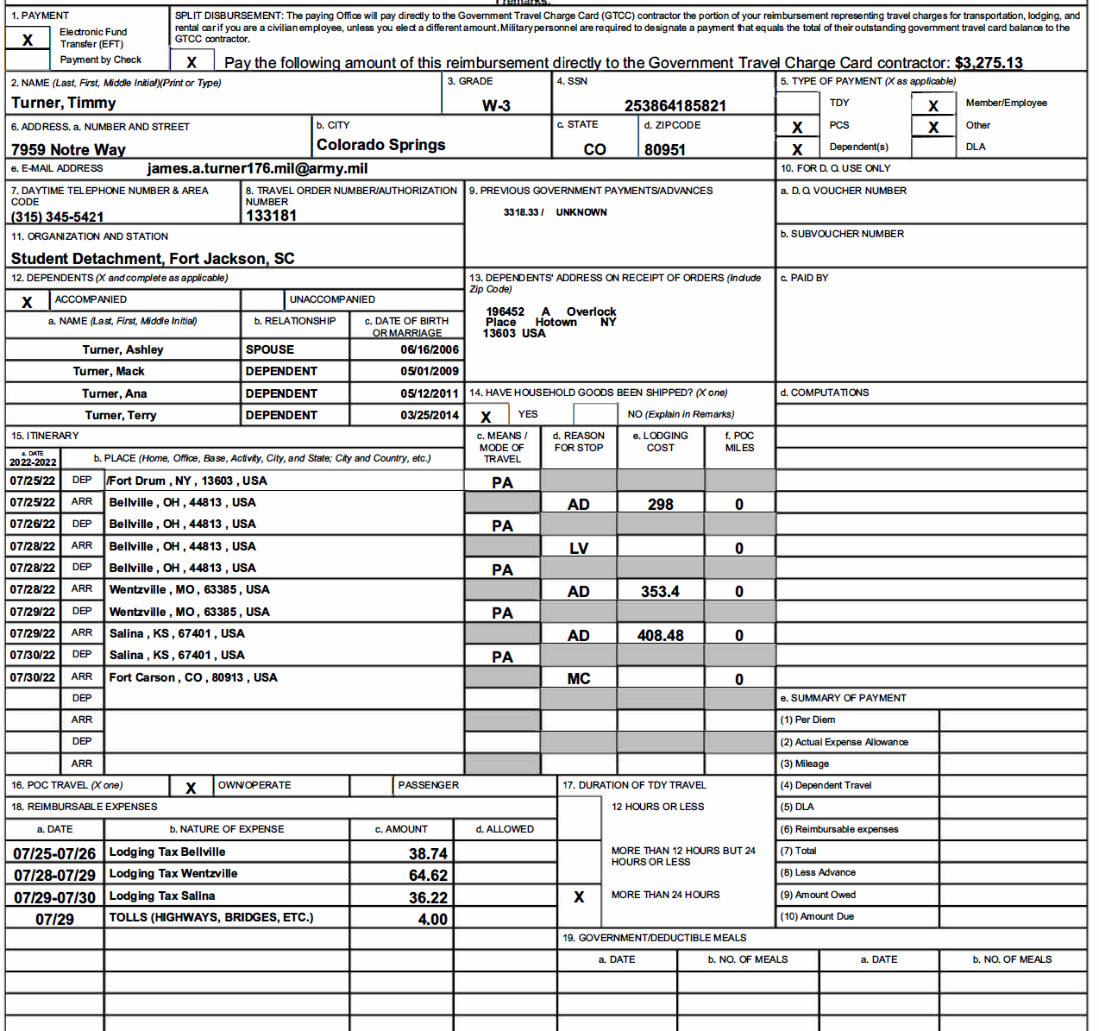
DD 1351-2 MAY 2011

Slide 28
DD 1351-2 MAY 2011
Do NOT submit your Travel Voucher WITHOUT YOUR SIGNATURE on Block 20A

Slide 29
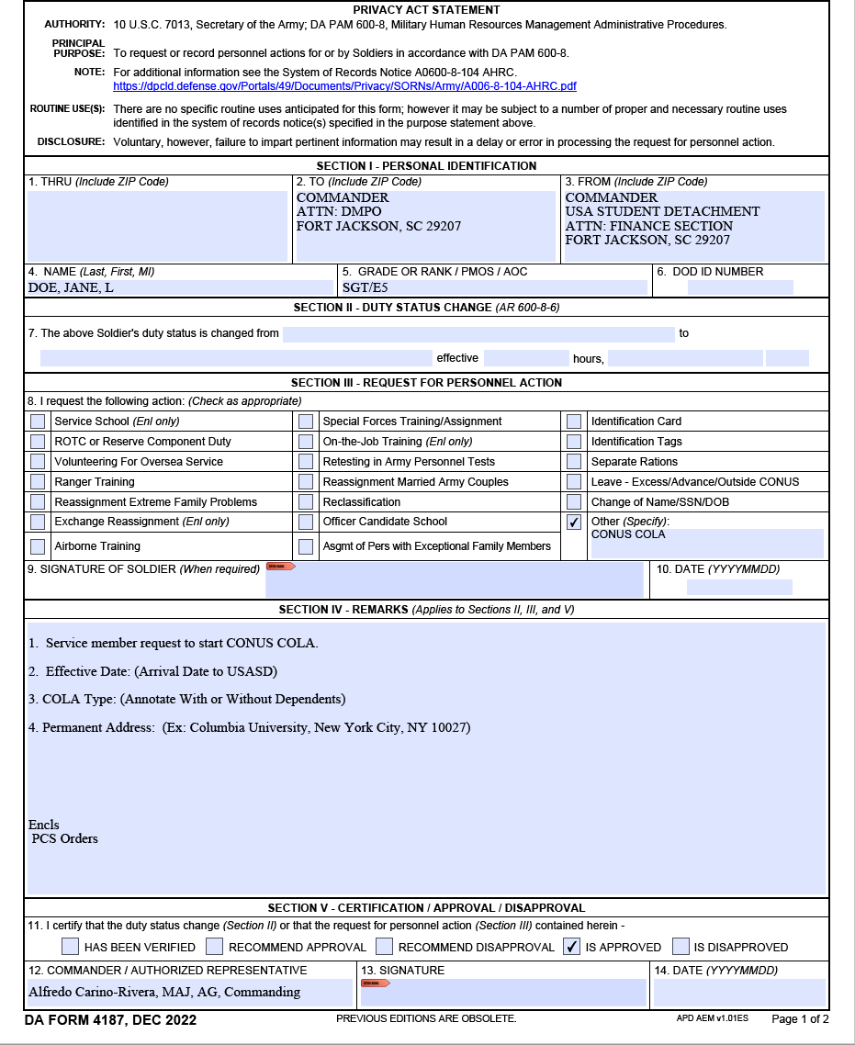
COLA DA 4187
# of Dependents. Do Not include yourself.

Slide 30
Contact Information
Reps & Letter Groups
Ms. Delphinia Ashley (803)-751-5747 (A–M)
Ms. Kimberly Finch (803)-751-9824 (N – T)
SPC Oksana Cruz (803)-751-6467 (U – Z)
The FIRST letter of your Last Name will be used to determined who is your Representative
Finance In-Processing: usarmy.jackson.93-sig-bde.mbx.ltb-sd-finance-pay-inquiries@army.mil
Ms. Deborah Smalls (Finance Lead) (803)-751-3626
SGT Joshua Fuentes (Finance NCOIC) (803)-751-5393
Please communicate with your representative.

Slide 31
AMERICA’S ARMY:
Globally Responsive, Regionally Engaged
UNCLASS/FOUO
United States Army Student Detachment
OUT-PROCESSING
4/21/2023

Slide 32
Out-Processing
Overview
If you are moving to another duty station, you should begin your permanent change of station (PCS) process upon receipt of assignment notification
Plan your departure from USASD accordingly. Do not assume you know the answer
Soldiers are strongly advised not to take any irreversible action prior to receiving PCS orders

Slide 33
CONUS Checklist
Absence Request
Soldier Talent Profile https://my.ippsa.army.mil
DA Form 7415, Exceptional Family Member Program (EFMP) Query Sheet https://armypubs.army.mil/default.aspx
DA Form 5434, Sponsorship Program Counseling and Information Sheet (print from ACT - Army Career Tracker https://actnow.army.mil)
TDY Option Statement required for TDY enroute (ATRRS Reserved) to gaining command. (For Soldiers who are authorized movement of family members at Government expense)
Complete Member Elections, and notify USASD by email of completion to the following email address: usarmy.jackson.CAC.mbx.usasd-out-processing@army.mil
If you have not received PCS Orders within 120 days of your report date, please contact the student detachment
Do not contact the student detachment unless you are within 120 days of your report date, in reference to receiving PCS orders

Slide 34
CONUS Checklist
DA Form 5434
Sponsorship Program Counseling and Information Sheet
Soldiers in the rank of PVT-SSG, WO1-CW2, and 2LT-CPT are required to participate in the program, except those on assignment to a PCS length school (less than 20 weeks). An assigned sponsor or an approved exception to policy is required to out-process
Soldiers in the rank of SFC - CSM, CW3 - CW5, & MAJ - COL may opt-in to participate in the program if they wish to request sponsorship
Upon receiving assignment instructions, the Soldier must login to the Army Career Tracker (ACT) website at: https://actnow.army.mil
Click on the Sponsorship tab and then DA Form 5434 (Sponsorship Program Counseling and Information Sheet). Select “create new form” and complete sections 1, 2, 4 and 5
Once each section is complete, a checkmark will appear. When all sections are complete, select the “submit” button on the bottom of the page
Once a sponsor is assigned by the gaining unit, the sponsor can log into ACT and complete the DA Form 5434, section 3. The DA Form 5434 can be completed by the Soldier/sponsor simultaneously

Slide 35
OCONUS Checklist
OCONUS ACCOMPANIED Checklist
Absence request
DA Form 5434, Sponsorship Program Counseling
DA Form 5121, Overseas Tour Election Statement
DA Form 4036, Medical and Dental Preparation for Overseas Movement
DA Form 4787, Reassignment Processing
Family Member Verification Letter
Family Member Declaration (Offense)
DA Form 5888, Family Member Deployment Screening Sheet
DA Form 7246, Exceptional Family Member Program (EFMP) Screening Questionnaire
DD Form 2792, Family Member Medical Summary, if applicable
DD Form 2792-1/IEP, Special Education/Early Intervention Summary, if applicable
Regional Health Command Europe Memo (Europe only)
Korea CS Memo (Korea only)

Slide 36
OCONUS Checklist
.
Absence request
PCS absence must start no later than the 11th day following graduation/completion date. (See Policy Memorandum #14 PCS Leave)
The absence will cover from date of departure from losing unit to reporting date in orders, even if early report is authorized. The TO date on the absence request must be the day before the report date on the PCS orders. Permission to report early does not change the reporting date. (IAW 600-8-10 Para 4-7)
Block 7. ORGANIZATION, STATION, POC EMAIL AND PHONE NUMBER
USASD/University Name or Training Location Name
  Duty location/School address:
  Duty Location City, State and Zip code:
  Phone: Use the Staff Duty Phone number (803) 429-5139

Slide 37
OCONUS Checklist
.
Absence Request – IPPS-A
***From the desk of the Detachment Commander:***
USASD will NOT accept absences outside of the Integrated Personnel and Pay System-Army (IPPS-A). If you do not have a supervisor in your local organization:
List Ms. Morris, Gayle as the Supervisor
Admin absence/House hunting (PTDY) is a separate request from an absence request or PCS absence request
Combined absences must cover all days that you are not present for duty. You must be on an approved absence to begin your travel. Service members are not authorized to travel while on PTDY status.
Absence date must end the day before your report date
  (Example) Report Date: 21 September; Absence request last date: 20 September
  For questions or RFIs please email: usarmy.jackson.CAC.mbx.usasd-da31@army.mil
  Ms. Gayle Morris 803-751-5325
Parental Absence
OCONUS Absence

Slide 38
OCONUS Checklist
DA Form 5434
Sponsorship Program Counseling and Information Sheet
Soldiers in the rank of PVT-SSG, WO1-CW2, and 2LT-CPT are required to participate in the program, except those on assignment to a PCS length school (less than 20 weeks). An assigned sponsor or an approved exception to policy is required to out-process
Soldiers in the rank of SFC - CSM, CW3 - CW5, & MAJ - COL may opt-in to participate in the program if they wish to request sponsorship
Upon receiving assignment instructions, the Soldier must login to the Army Career Tracker (ACT) website at: https://actnow.army.mil
Click on the Sponsorship tab and then DA Form 5434 (Sponsorship Program Counseling and Information Sheet). Select “create new form” and complete sections 1, 2, 4 and 5
Once each section is complete, a checkmark will appear. When all sections are complete, select the “submit” button on the bottom of the page
Once a sponsor is assigned by the gaining unit, the sponsor can log into ACT and complete the DA Form 5434, section 3. The DA Form 5434 can be completed by the Soldier/sponsor simultaneously

Slide 39
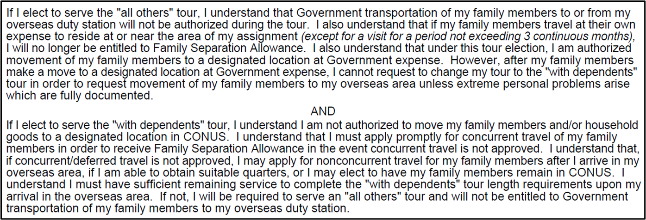
OCONUS Checklist
DA Form 5121
Overseas Tour Election Statement
Soldiers on assignment to an overseas duty station must elect either an “all others (unaccompanied)” tour or a “with dependents (accompanied)” tour*
Tour lengths can be found in DoD Instruction (DoDI) 1315.18 “Procedures for Military Personnel Assignments.”
Read each statement on the form carefully before making the decision

Slide 40
OCONUS Checklist
DA Form 5121
“ALL OTHERS”/Unaccompanied
Soldiers on assignment to dependent-restricted tours are authorized to move Family members to a designated place, unless participating in the HAAP
Soldiers who elect to serve an unaccompanied tour are authorized to move Family members to a designated place
When completing the DA Form 5121 and electing an “All-Others” tour, you must provide city, state, and zip code, where dependents will be located
Family members cannot be moved again at government’s expense until subsequent PCS, or if the Soldier serves a consecutive overseas tour
The designated place may be:
  Any location in CONUS
  Alaska, Hawaii, Puerto Rico, or US territory/possession (losing installation commander approval)
  The follow-on PDS (dependent-restricted and unaccompanied tours only)
  Any OCONUS location approved by the Secretary of the Army (dependent-restricted tours only)

Slide 41
OCONUS Checklist
DA Form 5121
Accompanied
Soldiers who desire accompanied Family members to overseas duty station (not a dependent-restricted tour) must apply for Command Sponsorship/Family Travel as soon as possible. The gaining command is the only command sponsorship approving authority
The Family travel authorization must be included on Soldiers’ PCS orders, with Family members listed by name
Command sponsorship will not be granted to a Family member who is a registered sex offender
Requests for Family travel must include:
  DA Form 5121 (Overseas Tour Election Statement) electing to serve with dependents
  DA Form 4787 (Reassignment Processing) listing all authorized dependents who will accompany the Soldier
  DA Form 5888 (Family Member Deployment Screening Sheet): All Family members must be screened at an EFMP clinic
  DD Form 2792 (Family Member Medical Summary) and or DD Form 2792-1 (Special Education/Early Intervention Summary), if applicable
Once all documents have been received by the Out-Processing Team, they will forward the request to the gaining command. The gaining command may take up to 30 days to process the request
Once command sponsorship is approved by the OCONUS command, the Family member(s) can submit passport/visa application(s). It can take 4-6 weeks to complete this process and receive the passports/visa

Slide 42
OCONUS Checklist
DA Form 4036
Medical and Dental Preparation for Overseas Movement
All Soldiers on a OCONUS assignment must get this form completed. All Soldiers must have a current HIV test on file
Date, time, and location of test will be annotated on DA Form 4036
This cannot be completed more than six (6) months prior to your report date

Slide 43
OCONUS Checklist
DA Form 4787
Reassignment Processing
List all authorized dependents who will accompany the Soldier
Soldier is required to complete items 3 to 17a
If an item does not apply, disregard and move to the next item (items 7B and 7C can be skipped

Slide 44
OCONUS Checklist
DA Form 5888
Family Member Deployment Screening Sheet
Soldier will complete (blocks 1-7) and authenticated by the Out-Processing Team (block 8)
DA Form 5888 will need to be signed by Out-Processing Team before EFMP will schedule your appointment
MUST be stamped by EFMP office
DD FORM 2792
Family Member Medical Summary
EFMP office will submit DD Form 2792, Family Member Medical Summary and /or DD Form 2792-1/IEP, Special Education/Early Intervention Summary to gaining command if applicable

Slide 45
Out-Processing
Mrs. Bost-(803)-751-3566 (A–M)
SFC Mims-(803)-751-4340 (N-Z)
The FIRST letter of your Last Name will be used to determined who is your Representative
HOURS OF OPERATION
Monday through Friday: 0830-1630
Phones Open for Customer Service: 1300-1600
LUNCH Monday through Friday: 1200-1300
SharePoint Link: https://armyeitaas.sharepoint-mil.us/sites/TR-CIMT-LTB-USASD
  Website Link: https://intranet.tradoc.army.mil/sites/USASD/SitePages/USASD%20Home.aspx
Email Out-Processing: usarmy.jackson.CAC.mbx.usasd-out-processing@army.mil
Army Publishing Directorate/APD https://armypubs.army.mil/default.aspx

Slide 46
HR Essential Personnel Services
United States Army Student Detachment
ESSENTIAL PERSONNEL SERVICES

Slide 47
HR Essential Personnel Services
Overview
To provide effective and prompt HR services to students geographically dispersed across the globe. Updates to student STP/Personal Profile are conducted by the submission of a Personal Action Request (PAR) in IPPS-A for all records updates and HQDA Promotion Boards:
  Assignment history
  Military schools
  Tour history
  Personal data and awards
  Provide regulatory guidance and support for personnel actions and other HR related issues

Slide 48
HR Essential Personnel Services
STP/Personal Profile Updates:
  Send copy of STP & spreadsheet to SM, update assignment history, current address, military schools, add awards and personnel data
  SM must submit all supporting documents required for updates
usarmy.jackson.93-sig-bde.mbx.ltb-sd-orb-erb-updates@army.mil
IPERMS/PRR:
  Batch correspondence for iPerms upload
  Initiate PRR's, SM loads LES, complete and sign PRR
usarmy.jackson.93-sig-bde.mbx.ltb-sd-iperms-updates@army.mil
HR PERSONNEL ACTIONS:
Most common Actions Request:
  Unqualified resignation
  ILE deferment/YMAV extension
  Married Army Couples Program (MACP)
  Training with Industry application (TWI)
  National Intelligence University Master of Science in Technical Intelligence (NIU-MSTI)
  Foreign Language Proficiency Bonus (FLPB)
usarmy.jackson.93-sig-bde.mbx.ltb-sd-personnel-actions@army.mil

Slide 49
HR Essential Personnel Services
Mr. Phillip Cobble (803)751-5389
Mr. Steven Thomas (803)751-5382
HOURS OF OPERATION
Monday through Friday: 0830-1630
Phones Open for Customer Service: 1300-1600
LUNCH Monday through Friday: 1200-1300
SharePoint Link:
https://armyeitaas.sharepoint-mil.us/sites/TR-CIMT-LTB-USASD
Army Publishing Directorate/APD https://armypubs.army.mil/default.aspx

Slide 50
Closing Comments
4/21/2023
49

